Slide 1
Welcome to Hello World Series
Manage versions yourself and it’s challenges

Slide 2
In last tutorial...
We agreed that some sort of Version Control mechanism is required.

Slide 3
In this tutorial...
We will try to manage file changes on our local machine having incremental name for each revision.
Convention for each revision - filname_DDMMMYYYY_HH_MM.c

Slide 4
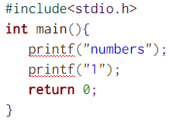
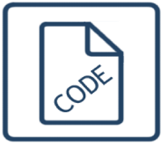
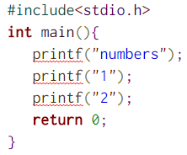
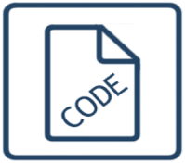
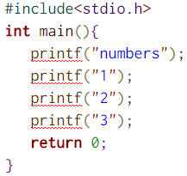

Local revisions
Convention for each revision - filname_DDMMMYYYY_HH_MM.c
Revision 1 – 09:14 AM
Revision 2 – 09:50 PM
Revision 3 – 10:30 PM
print_14Nov2016_09_14_AM.c
print_14Nov2016_09_50_AM.c
print_14Nov2016_10_30_AM.c

Slide 5

This story was simple – one file and one developer only
What if, you have many files and many developers

Slide 6
You definitely need some tool to help you!!!
Version control is a system that can track/control the changes your file(s) over time so that you or someone authorized person can recall specific versions later.
This so-called "Version Control System (VCS)" needs to be a software or a manual management of changes, which we will cover in next tutorials.
V
ersion
C
ontrol
S
ystem

Slide 7
Coming up Next
Version control with DBMS and it's problems
Notes:
In Slide Show mode, click the arrow to enter the PowerPoint Getting Started Center.

